Slide 1
World Language Assessment
2023-2024 Proctor Training
Everett Public Schools
Assessment and Research

Slide 2

Agenda
WLA Basics
Code of Conduct
Understanding the Assessment
Administration
  Script
  Keyboards and the writing test
  Troubleshooting
  Ending the test
School Coordinator Information
Q&A
Practice Activities in Teacher Monitoring Site

Slide 3



Why World Language Assessment
Students can earn up to 4 credits in high school world language, starting in 7th grade
  Frees up time in student schedules for core courses or other priorities like AP, College in High School, CTE
Students who earn 4 credits and meet all high school English credit and pathway requirements earn special honors at graduation (Seal of Biliteracy):
  Shiny medal
  Fancy seal on the diploma
  College and career advantages based on certified biliteracy
Many students have never received positive attention for speaking another language.
They deserve credit for this wonderful skill.

Slide 4
Code of Conduct
It is your responsibility to ensure that standard procedures are followed.
Follow testing protocol indicated in this training
Follow national, district, and school security procedures for distribution, and return of secure assessment materials. (Chain of Custody)
Monitor the classroom. Watch for irregularities during testing and document any inappropriate behavior during testing.
    DO NOT help with anything that is related to the content of the test items.
    Proctor, student, nor any other party shall make a copy – by hand, camera, phone, printer, or any machine – of any test materials.
As always, follow the Code of Professional Conduct Chapter 181-87 WAC.

Slide 5
WLA Assessment Types
Assessment | Length & Format | Allowed Items | Later Date
STAMP 4S & WS | Online Untimed | Online: none | n/a
STAMP (Hybrid) | Online reading, speaking, listing Print on demand writing section | Online: none Paper test: Black pen Correction fluid | n/a
ALTA | Writing: 1 hour timed Paper/Pen | Black pen Correction fluid Extra paper | Speaking/Listening: 25 minute phone interview scheduled by SAC after writing scoring
Notes:
Pass out Example Altas and WAFLTS

Slide 6
School: Organizing Testing Ahead of Time
Try to organize your testing by test type to reduce complications:
              Avant online tester no keyboard change.
              Avant online tester needs keyboard change.
              Avant paper writing testers
              ALTA timed paper testers
                Make-up testers of any kind
Williams, Bobby
Dutch
https://app.avantassessment.com
Test Code: 12345
Password: 6789
Login Name/Test Taker ID: student ID#
Keyboard Change
Paper Writing
Cascade

Slide 7
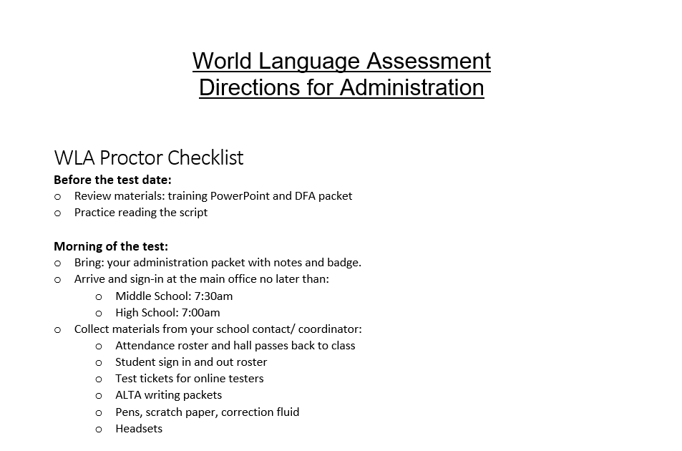
Directions for Administration Review
Pull out the DFA and a highlighter!
Notes:
https://docushare.everett.k12.wa.us/docushare/dsweb/Get/Document-121378/WLA%20DFA%20Final.pdf

Slide 8
Typing in other alphabets
Nearly all tests have special characters preloaded into the test except: Amharic, Arabic, Armenian, Cantonese, Chinese (Mandarin) Simplified & Traditional, Hebrew, Hindi, Japanese, Korean, Marathi, Russian, Tamil, Telugu, Vietnamese, and Urdu
For only these languages, students will need to change keyboards. Their tickets are labeled and will be a different color.
Middle school students and high school students use different devices and have different instructions.
School Tip:
  Schedule students who need their keyboards changed to come in on the same date.
  Consider calling those students in prior to the test to load the keyboards early so the students can practice them. You will want your field tech present.

Slide 9



Middle School Language Keyboards
Only these languages need keyboard changes: Amharic, Arabic, Armenian, Cantonese, Chinese (Mandarin) Simplified & Traditional, Hebrew, Hindi, Japanese, Korean, Marathi, Russian, Tamil, Telugu, Vietnamese, and Urdu
1
2
3
Switch keyboard using Google Input Tools
Did it work? Type out a few sentences in a Google Doc
Didn’t work? Add characters to Chrome
4
Still didn’t work? Provide hybrid code instead or call your Field Tech over for help.

Slide 10
High School Language Keyboards
Only these languages need keyboard changes: Amharic, Arabic, Armenian, Cantonese, Chinese (Mandarin) Simplified & Traditional, Hebrew, Hindi, Japanese, Korean, Marathi, Russian, Tamil, Telugu, Vietnamese, and Urdu
Turn off Grammerly!
Step1: Switch keyboard using Google Input Tools
Step 2: Try typing out a few sentences in a Google Doc
Didn’t work? Provide hybrid code instead or call your Field Tech over for help.

Slide 11
WLA Frequently Asked Questions
Q: Why do we refuse testing for students who can’t read and or write?
A: Credits are assigned based on the lowest domain scores:
Q: What if a student gets to writing and tells me they can’t write?
A: Clarify, can they not write or can they not type?
  Cannot type: start them over again with the hybrid code and call x4054.
  Cannot type or write by hand: send them back to class. Tell them that if they do learn to write they can test all the way until the spring of senior year.
Reading | Writing | Speaking | Listening | Credits
7 | 1 | 7 | 7 | 0
2 | 2 | 2 | 2 | 1

Slide 12
STAMP Tests Online vs. Hybrid
Students cannot switch between hybrid and online
Switching means starting over. Notify A&R if this needs to happen.
Students must check their language keyboards/stylus in a Google Doc, before starting the test.
Avant testers who indicated at registration that they could not type were ordered the hybrid test and their test ticket will be a different color.
Hybrid testers use a different session number for logging in than students taking the entirely online version of the same language.
Proctors will print the writing section for hybrid tests.
  If testing hybrid testers, locate the printer in the testing room and make sure someone present can print to it.
  The test is adaptive. Instruct hybrid testers to complete the reading section first so the writing test will generate.
  Students should complete reading, listening and speaking online and place their device under their desk. Then give them the writing test, pen, scratch paper, and correction tape.
School coordinators will scan STAMP paper tests and email to aschiessl@everettsd.org immediately after testing is done.
Notes:
Pass out Example Altas and WAFLTS

Slide 13
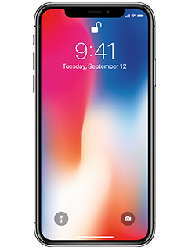
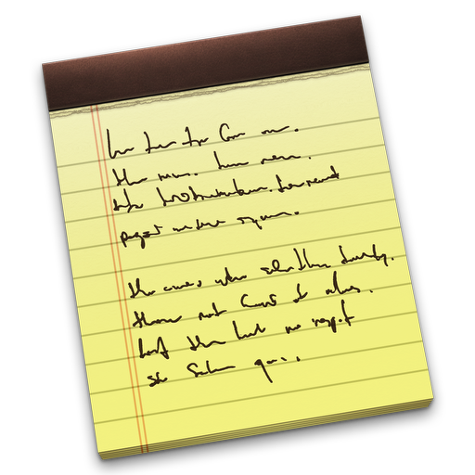


Prohibited Materials
Prohibited from all WLA Assessments:
      Electronic devices of any kind-- iPods, laptops, cell phones, cameras, smart-watches
      Dictionaries or notes
  Online Assessment Prohibited Materials:
      Additional computer applications (word, email, chat) or browser windows
      Paper, pens, pencils
  Paper Assessment Prohibited Materials:
      Pencils
WLA is a voluntary test, students who access prohibited items are dismissed from testing.
Proctors will immediately log that student out of the test and suspend testing for that individual.

Slide 14
During Testing
At least one proctor must remain in the testing area throughout testing. School staff may be called out, make sure you know how to reach them if needed.
Ensure no one enters the room once testing begins.
Monitor bathroom breaks
Actively monitor testing by walking the room to ensure:
    no prohibited items are being used- dismiss students
    students are making progress- students who cannot answer their items at all can leave testing early
Use the Teacher Monitoring Site to ensure students are progressing through each section
Assist online testers with headsets and/or computers.

Slide 15
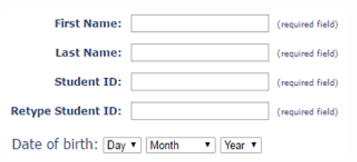
Troubleshooting Procedure
X
Have the student log out and back in with the exact credentials shown in the Teacher Monitoring Site. If it doesn’t work,
Call Avant (888-713-7887) with:
    Name
    Login
    Student ID
    Test code (from ticket)
If the Student Profile Screen appears, STOP the assessment.
Look in the Teacher Monitoring Site for the student login and have them enter their information exactly as entered previously.

Slide 16
Student Checkout Process
STAMP Testers:
Check that all sections are done in the Teacher Monitoring Site
The student logged out of the test and closed the browser
ALTA Testers:
The test and materials were collected.
Listen to student recordings to ensure they are clear
if not, contact AVANT to reset section
Hybrid testers have also completed their written test and returned their materials.
Once the above is completed, the student may then be signed out with the time and be given a hall pass to go to their regularly scheduled class.

Slide 17




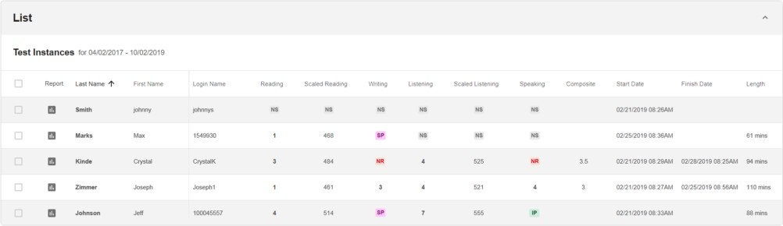
Checking for Section Completion
Done: Score (number) Not Done: Reset:
Do not reveal any scores as they are preliminary and credits are determined using a special scale.
Note: some languages separately score each domain and some combine domains and include into the writing and speaking sections and may include self-assessments.

Slide 18
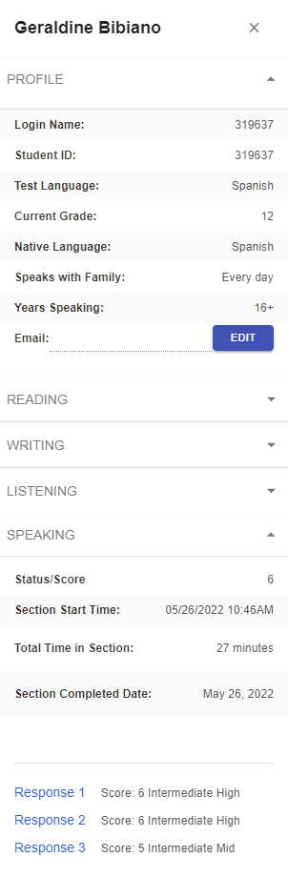
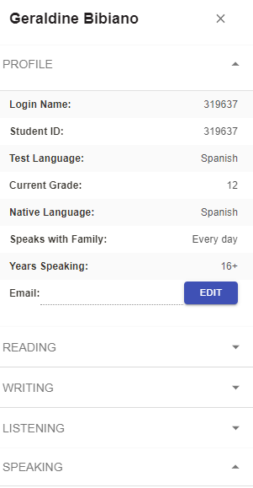
Checking for Completion: Listen to Audio
“Max Smith”
2. The student’s information will appear in the upper right.
“Max Smith”
1. Click on the student’s last name.
Smith
3. Click the speaking area carrot.
4. Click on the responses.

Slide 19
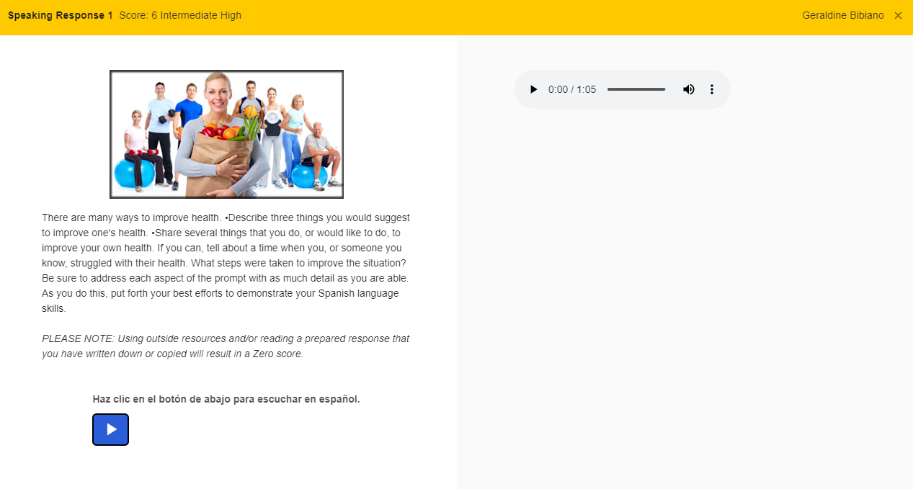

Checking for Completion: Listen to Audio
Student Name
Click the play button, is this clear and audible?
Yes, check the remaining.
If they are all audible make sure the student has logged out, returned their ticket and send them back to class.
If no, call Avant 888-713-7887 to reset the section, have the student log back in and redo it.
Prompt picture and written information here

Slide 20
School Process
Review
Review Materials
ALTA Telephone Instructions
Score to Credit Conversion Chart
Example Transcript Letter
Plan
Book an appropriate room for testing
Remind staff not to use GoGuardian/ Class Policy during testing
Test
Schedule ALTA Phone Interviews
Note 3 testing options and email to ALTA.
Distribute
Distribute Score Reports and Transcript Letters to students within one week of receipt.
Record
File Cum File copies within one week.
Update transcripts with proficiency info ASAP.
All proctor materials
Copy aschiessl.
Complete makeup testing and interviews by 12/15
There is no score repository at the state. If the student does not get credited on their transcript/ cum file copies filed, they will never get credit if they move.

Slide 21



Earning Credit and
Seal of Biliteracy
Credits
To get high school world language credits posted to transcripts:
    Parent and student sign the Transcript Letter and submit to their registrar at any time prior to graduation.
    Registrars will then add credits to the transcript.
  Seal of Biliteracy
  Students who qualify for 4 credits may also receive the Seal of Biliteracy on the diploma and special recognition at graduation.
  When student scores are returned staff at the student’s current school will indicate proficiency in that World Language on student’s transcripts.
  Once students have met their ELA graduation requirements and are ready to graduate, the seal will change to earned status.

Slide 22
Smart Thoughts
Schools should call for help if your proctor is not at school at the appointed time (4054)
Bring your instruction packet and use it
Type in the site correctly: app not apps
Give the correct test to the correct student
When changing Google keyboards:
      make sure they check that it is working in Chrome
      don’t forget that the student may need to pause their account in Chrome
Do not let students leave without you listening to their recordings for audibility– and make them re-record on site.

Slide 23
Help
High School
Middle School
CHS: Katherine Mayan x6092
    Philip Brandstetter
EHS: Erik Heinz x4489
    Shawn Keagle x4404
JHS: Sechin Tower x7073
Erin Thomsen, Joshua Stewart,
Ken Walker
SHS: Shelbey Kincannon x5138
Betsy Monroe x5101
EIS: Pachomius Schmidt x7591
    Gayatri Vankadra
EVG: Monica Haule x5791
  Sarala Kotcharlakota, Mary Forsberg
GWY: Jessica Perez x6610
HEA: Chris Doll x6391
Dylan Boling x6300
NOR: Allison MacGregor Fornes x4891
Marie Cave, Kathryn Mclain, Jeff Whitley
Avant Assessments: 888-713-7887 ∗ District Assessment Office x4054

Slide 24



Questions and Practice

Slide 25
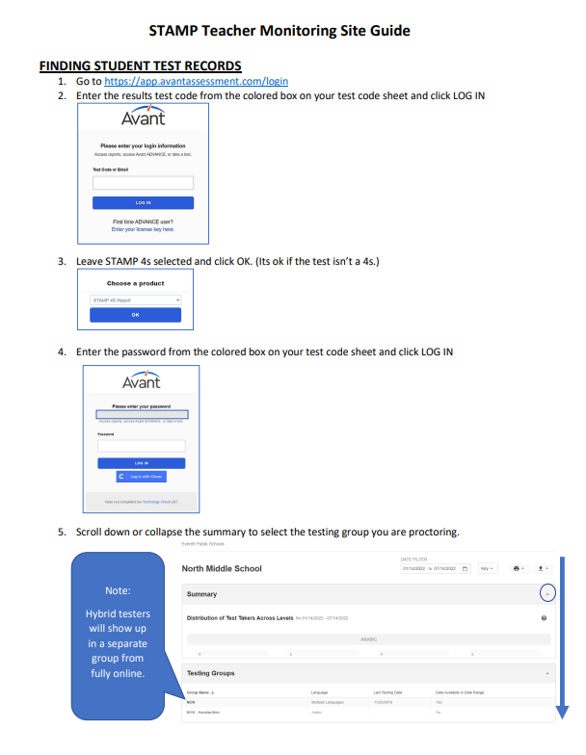

Teacher Monitoring Site Activity 1
Get out your STAMP Teacher Monitoring Site Guide and follow the instructions.
Log into AVANT teacher site by typing app.avantassessment.com/login
Login using the information on the big sticky. On the day of testing your school teacher code will on your list of codes in its own box.
Go to the group called “CHS”
Find the student listed and write down their status and listen to each audio item.
Raise your hand when you are done or if you get stuck.
Notes:
Everett-CHS-Results; Results7299

Slide 26
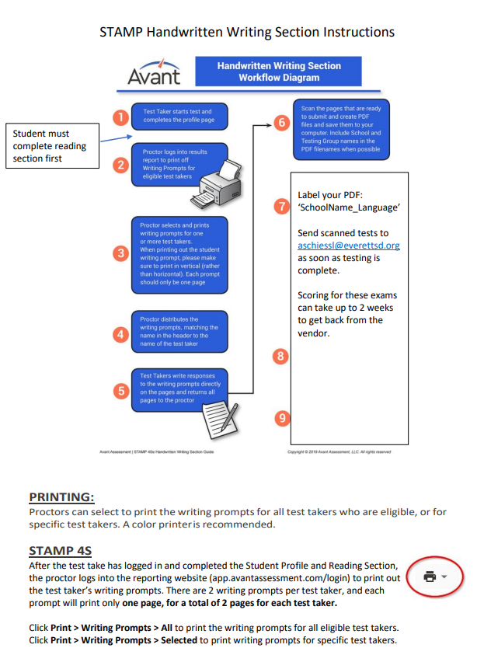
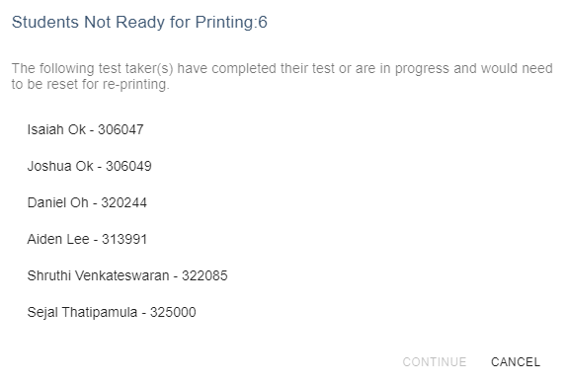
Teacher Monitoring Site Activity 2
Get out your STAMP Handwritten Writing Section instructions
Go back and this time go to the group called “CHS - handwritten”
Use the instructions to attempt to print writing sections.
Raise your hand when you get this screen or if you get stuck.
confidential
Notes:
Everett-CHS-Results; Results7299

